Slide 1
Included MTN

Slide 2
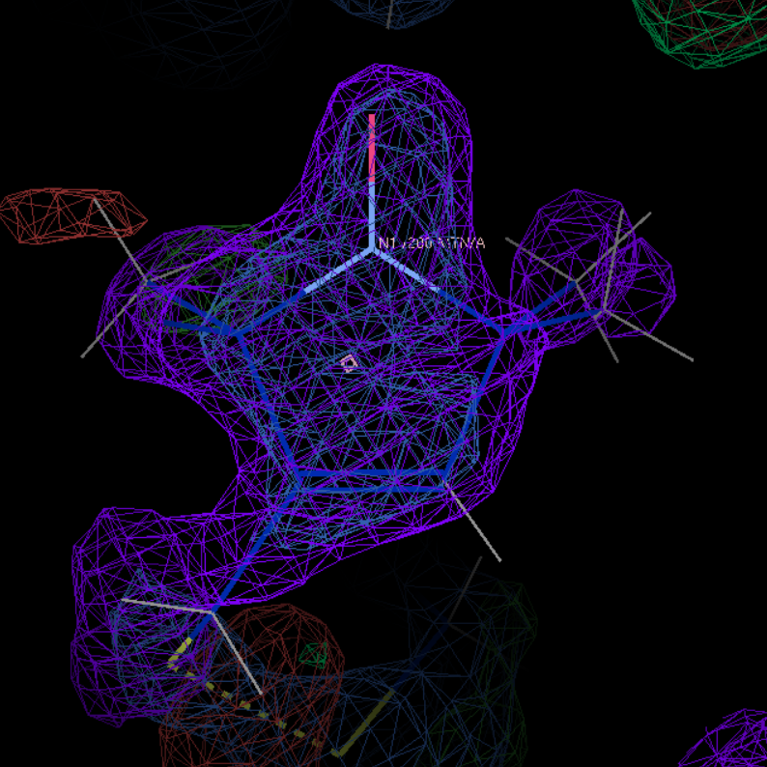
2igc
chain A and resseq 200

Slide 3
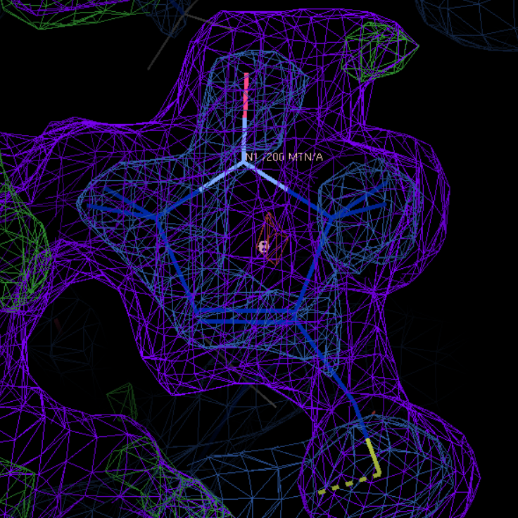
2nth
chain A and resseq 200

Slide 4
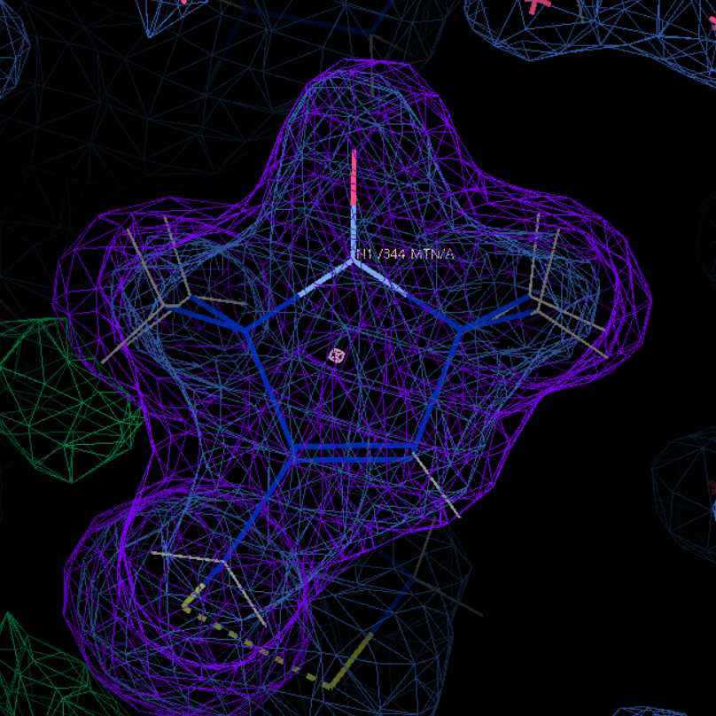
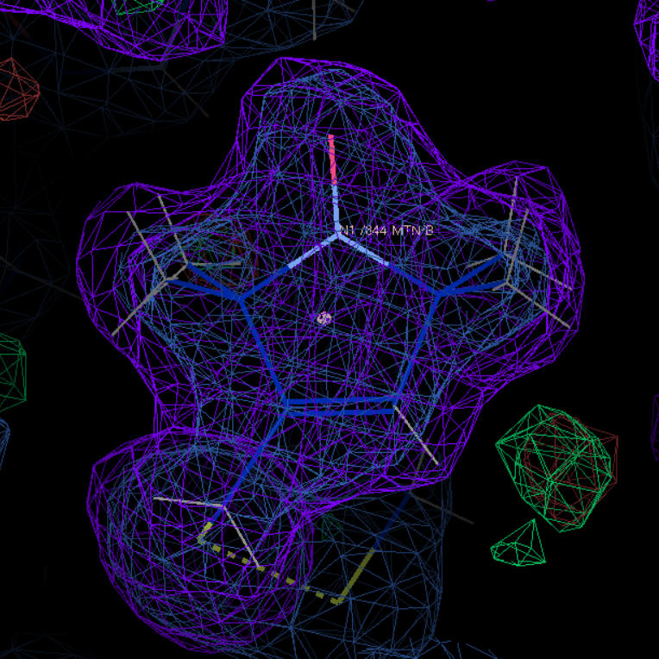
2q9e
chain A and resseq 844
chain B and resseq 844

Slide 5
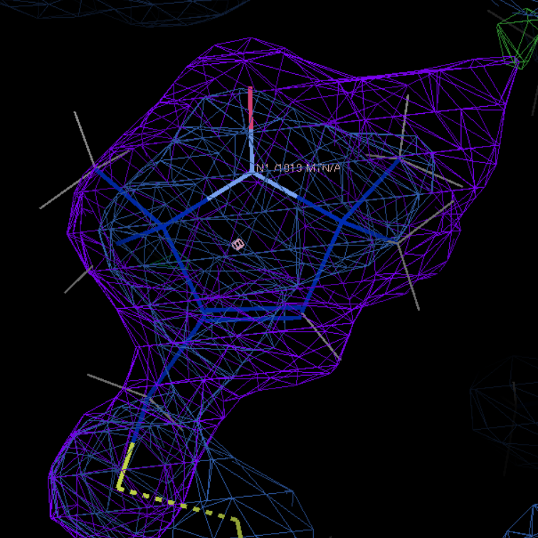
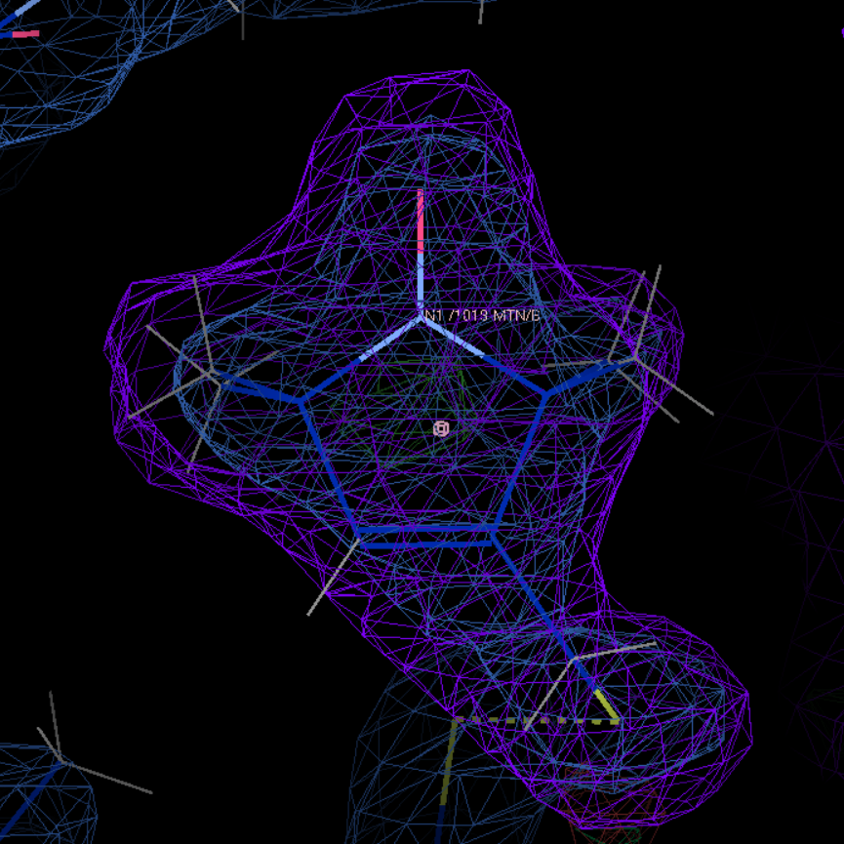
2xga
chain A and resseq 1019
chain B and resseq 1019

Slide 6
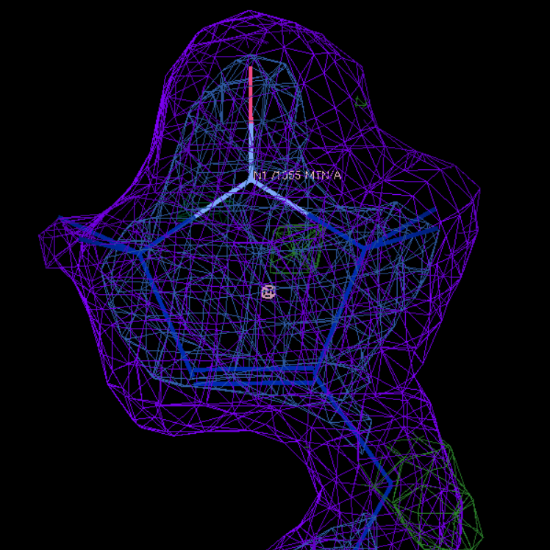
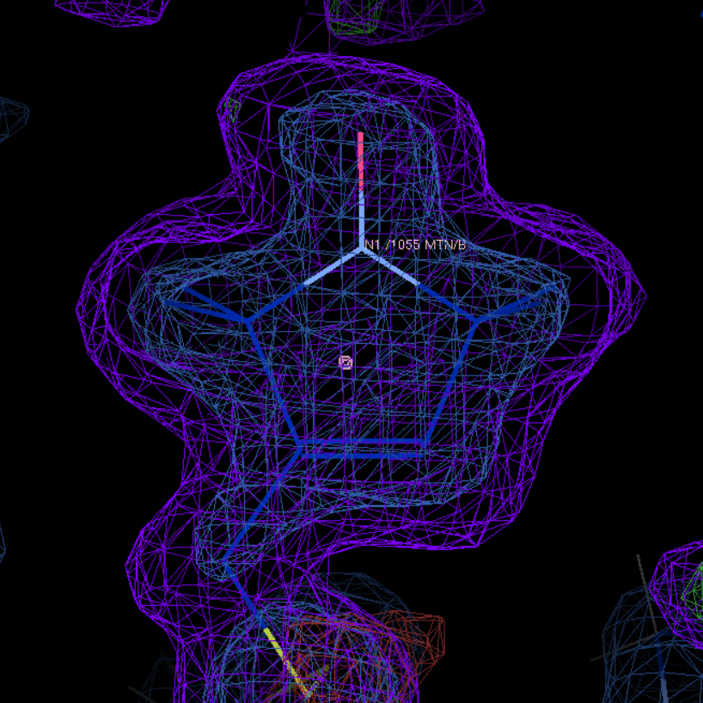
2xiu
chain A and resseq 1055
chain B and resseq 1055

Slide 7
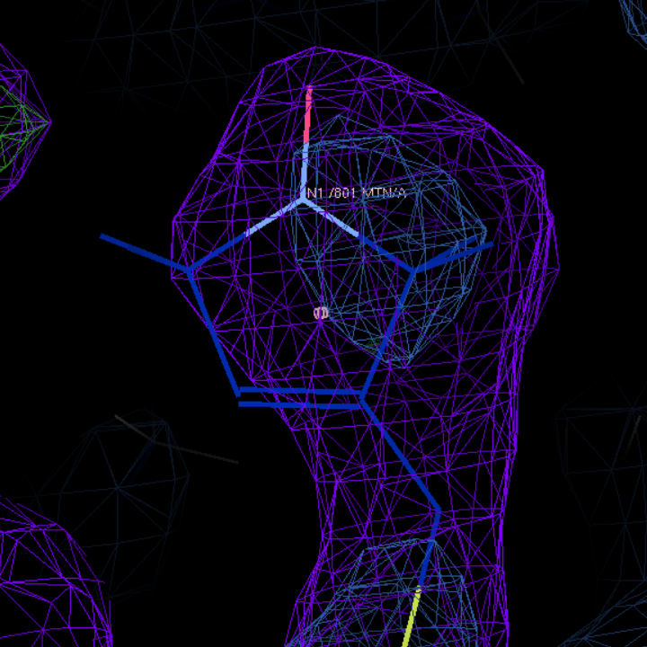
3mpn
chain A and resseq 801

Slide 8
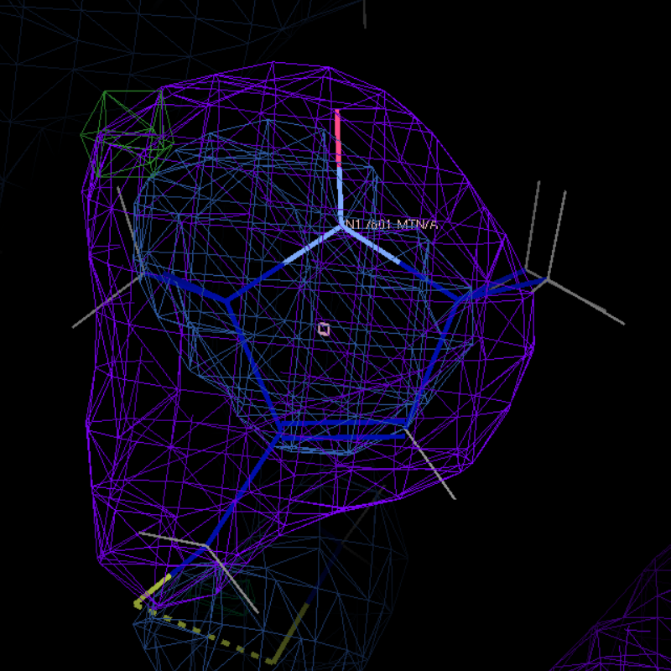
3mpq
chain A and resseq 801

Slide 9
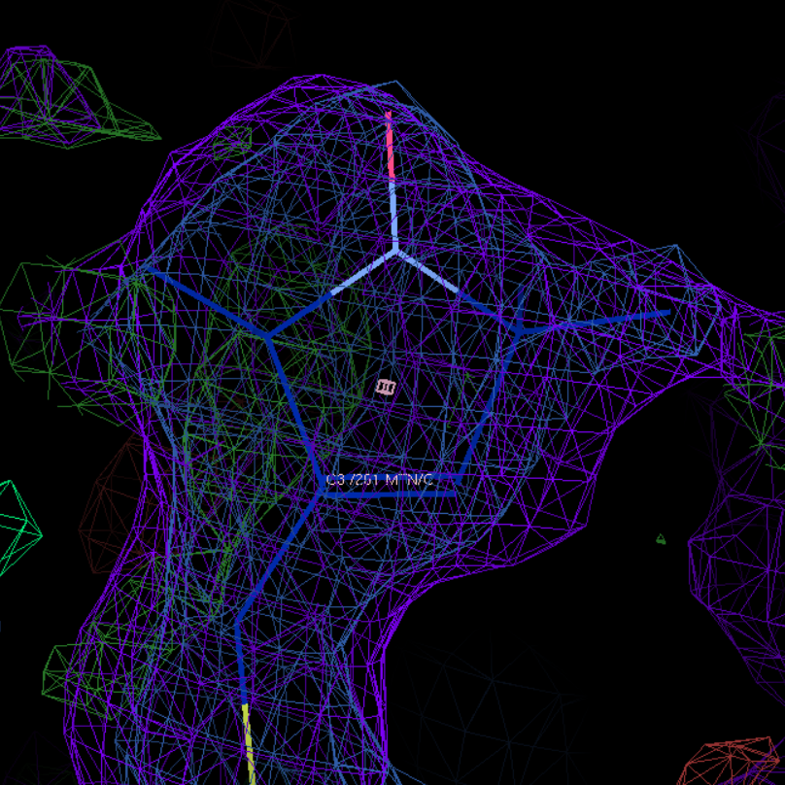
3stz
chain C and resseq 201

Slide 10
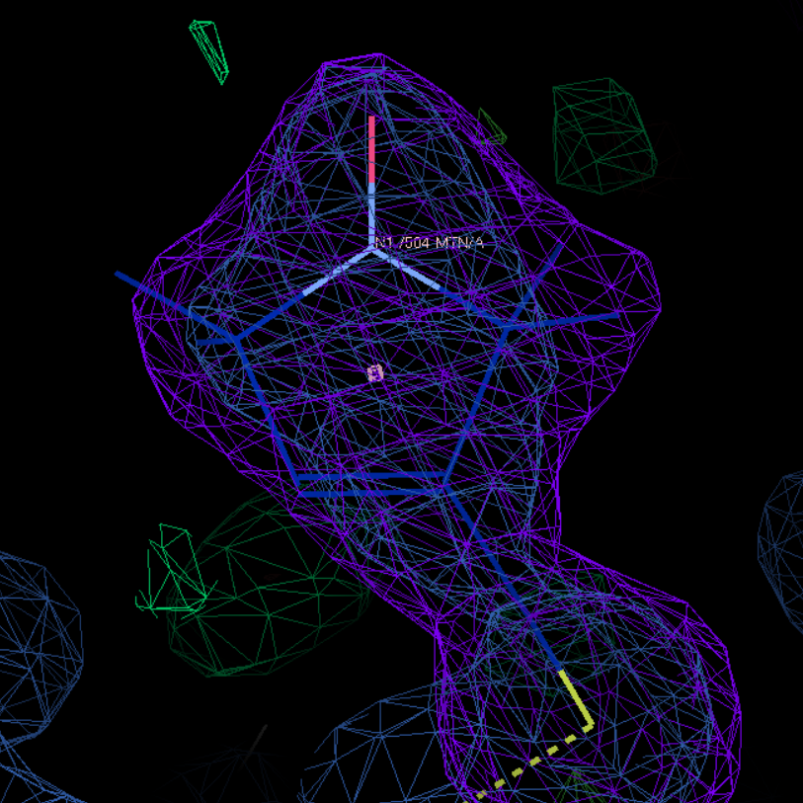
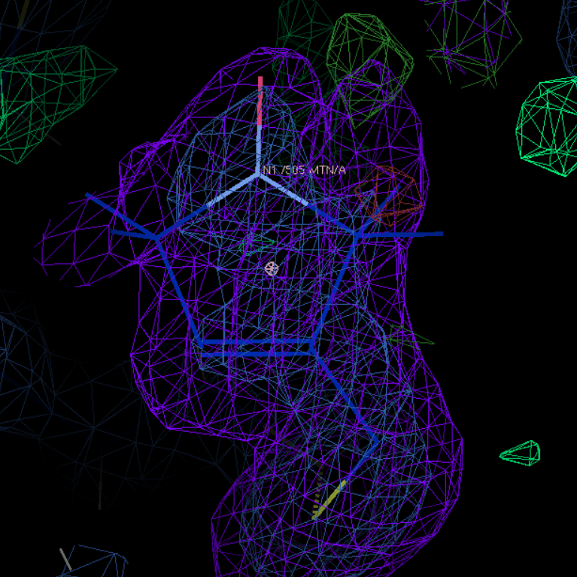
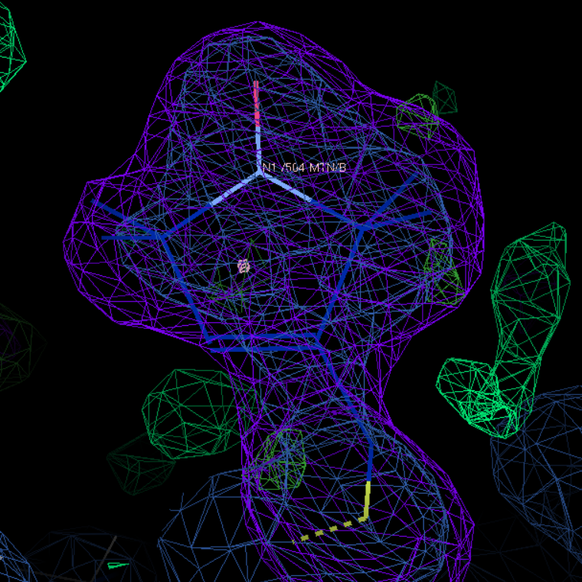
4ek1
chain A and resseq 504
chain A and resseq 505
chain B and resseq 504

Slide 11
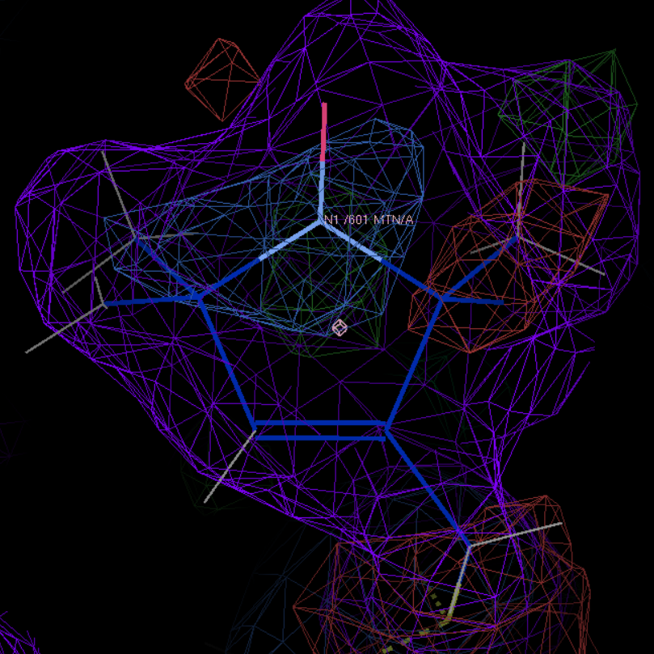
4wwl
chain A and resseq 601

Slide 12
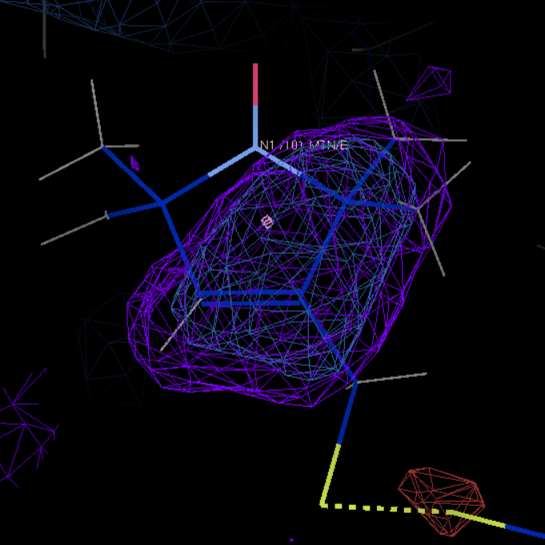
5bmg
chain E and resseq 101

Slide 13
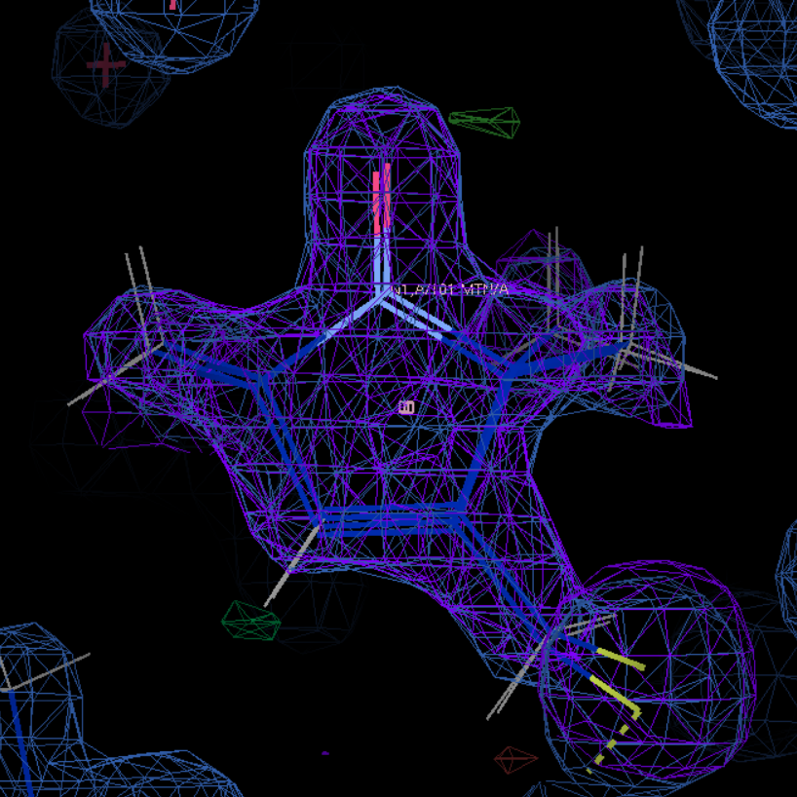
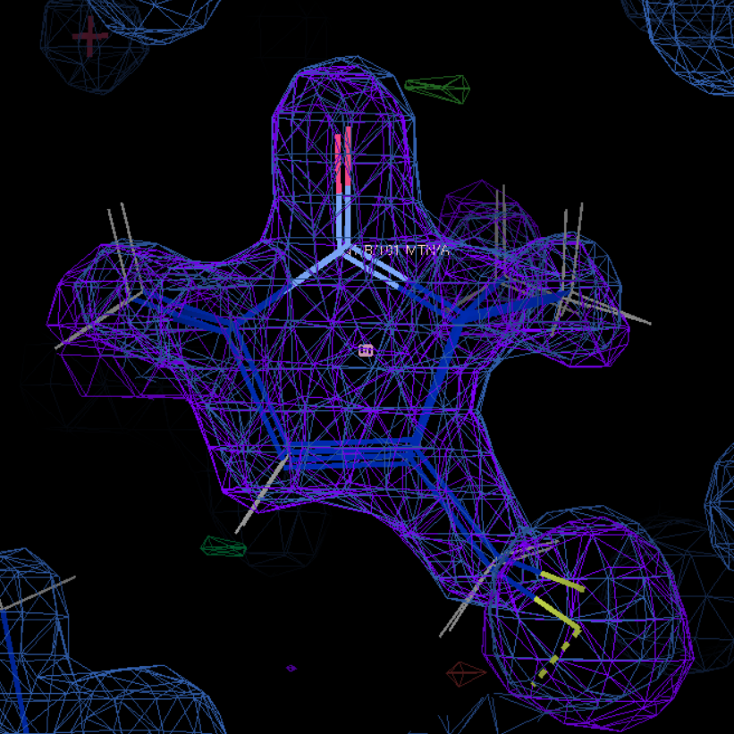
5bmh
chain A and resseq 101 and altloc A
chain A and resseq 101 and altloc B

Slide 14
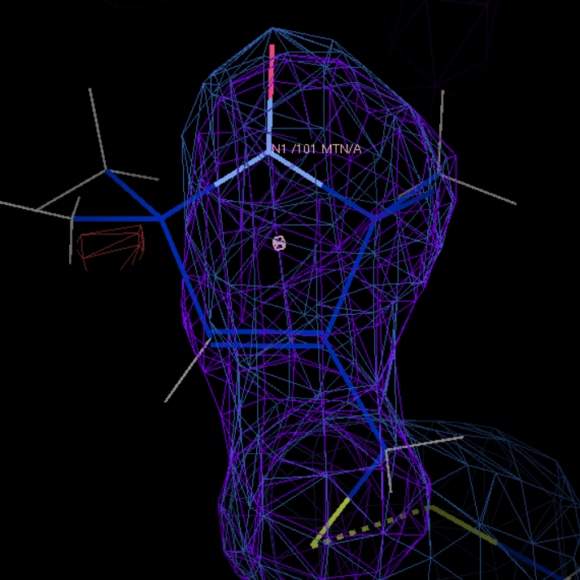
5bmi
chain A and resseq 101

Slide 15
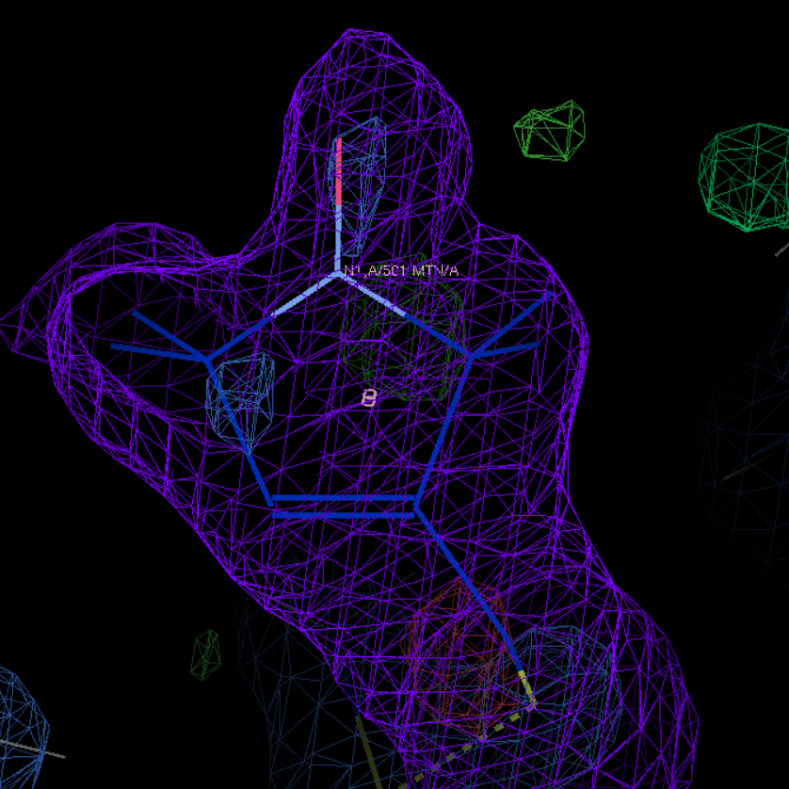
5g27
chain A and resseq 501

Slide 16
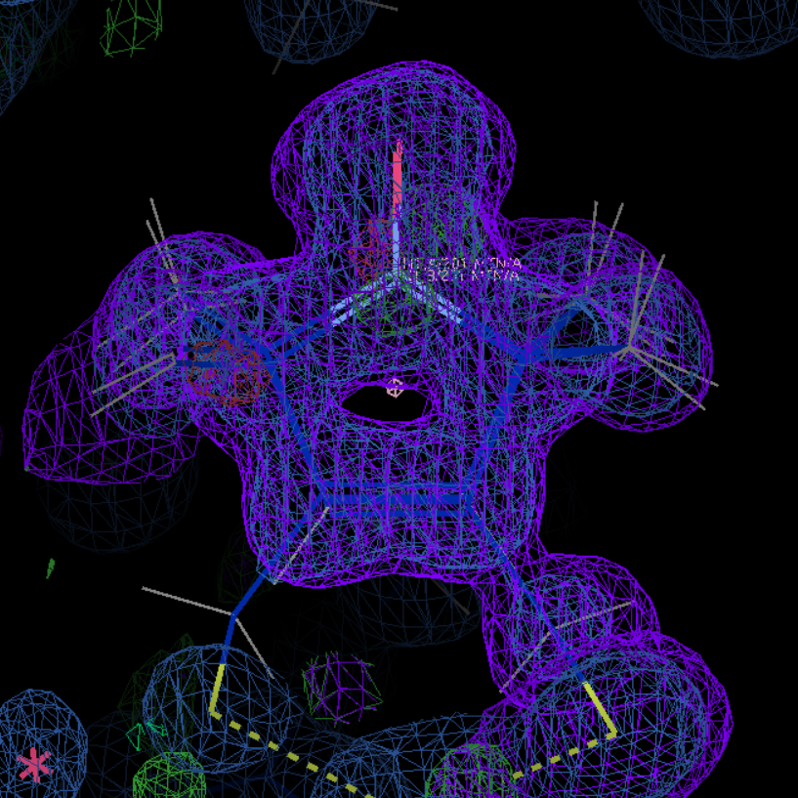
5jdt
chain A and resseq 201 and altloc B

Slide 17
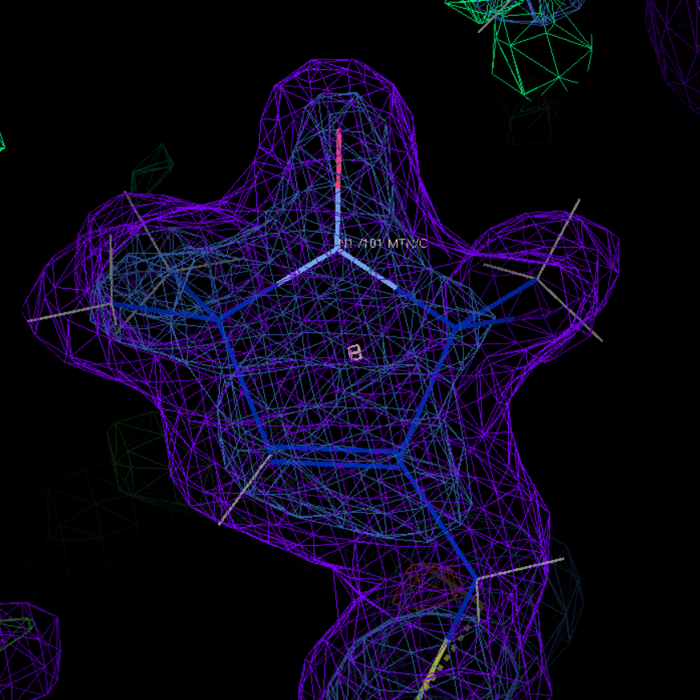
6n87
chain C and resseq 101

Slide 18
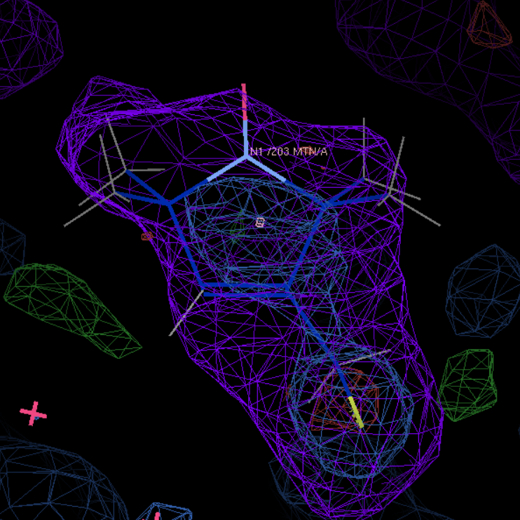
6pgy
chain A and resseq 203

Slide 19
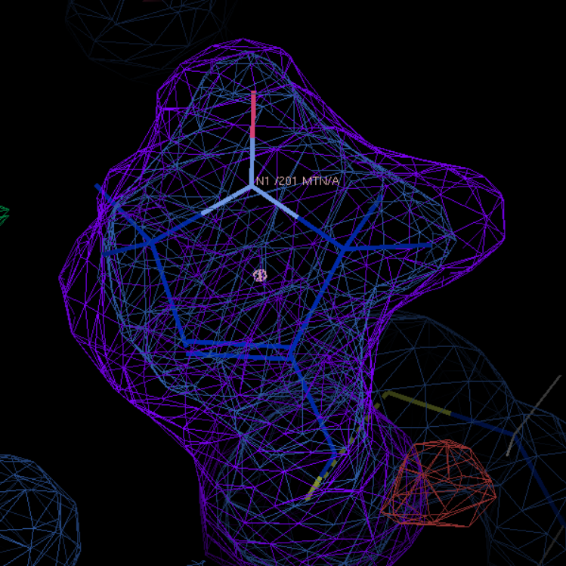
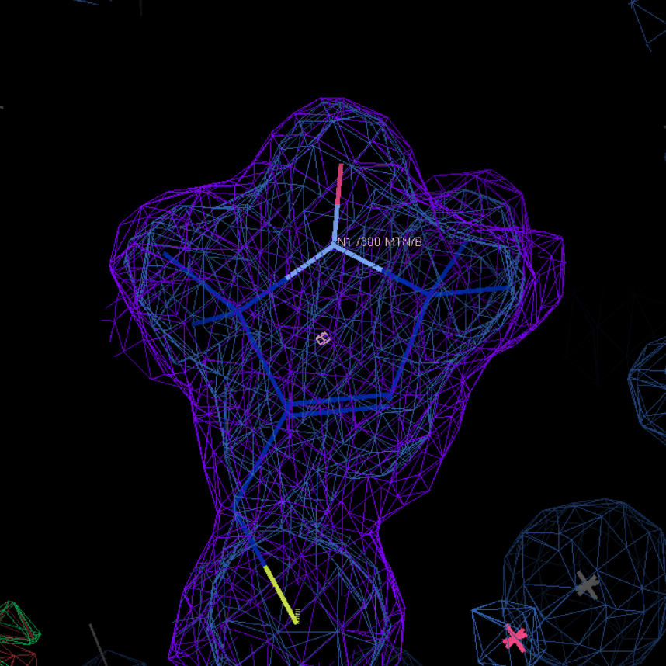
6pgz
chain A and resseq 201
chain A and resseq 300

Slide 20
Suspicious MTN

Slide 21
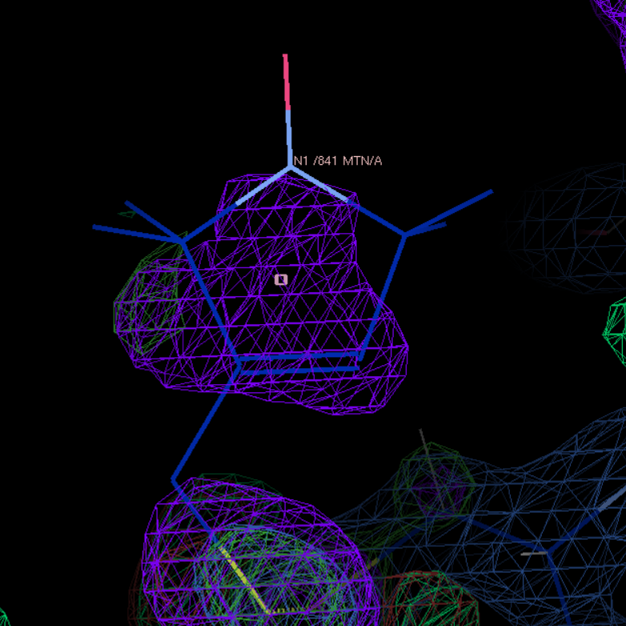
2q9d
chain A and resseq 841

Slide 22
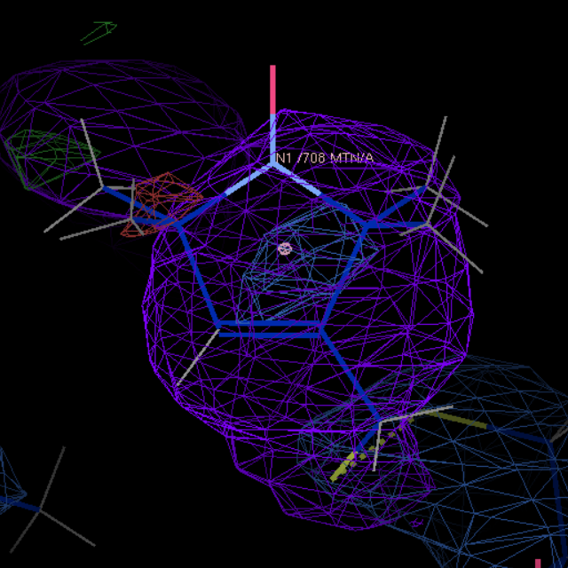
3m8d
chain A and resseq 708

Slide 23
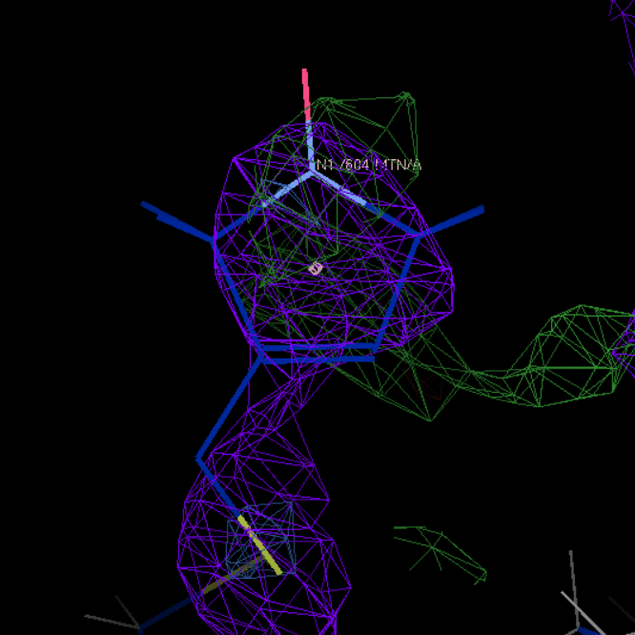
3rgm
chain A and resseq 604

Slide 24
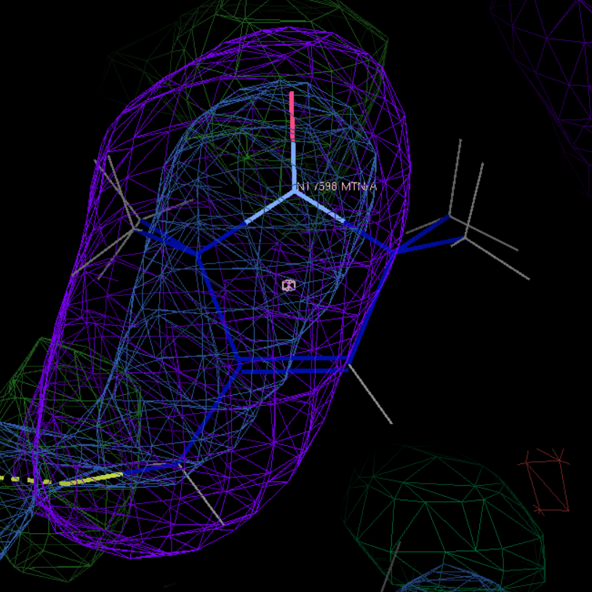
3rgn
chain A and resseq 598

Slide 25
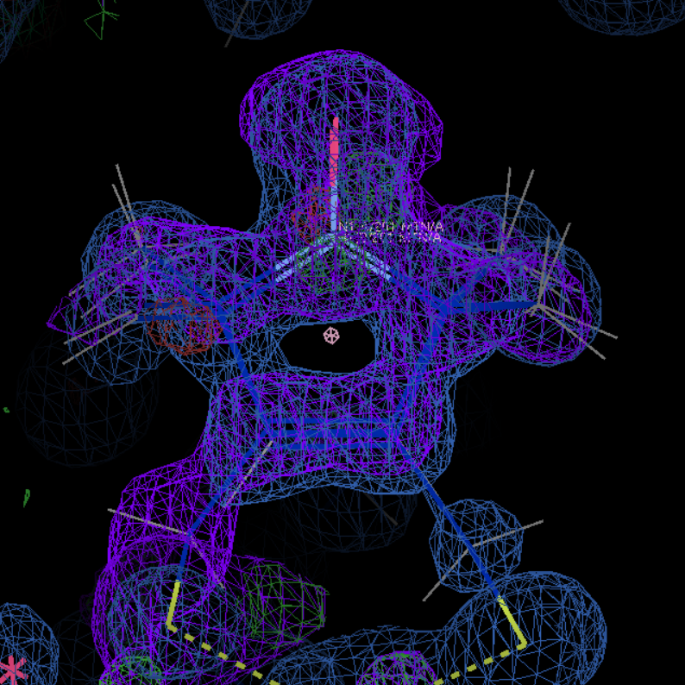
5jdt
chain A and resseq 201 and altloc A

Slide 26
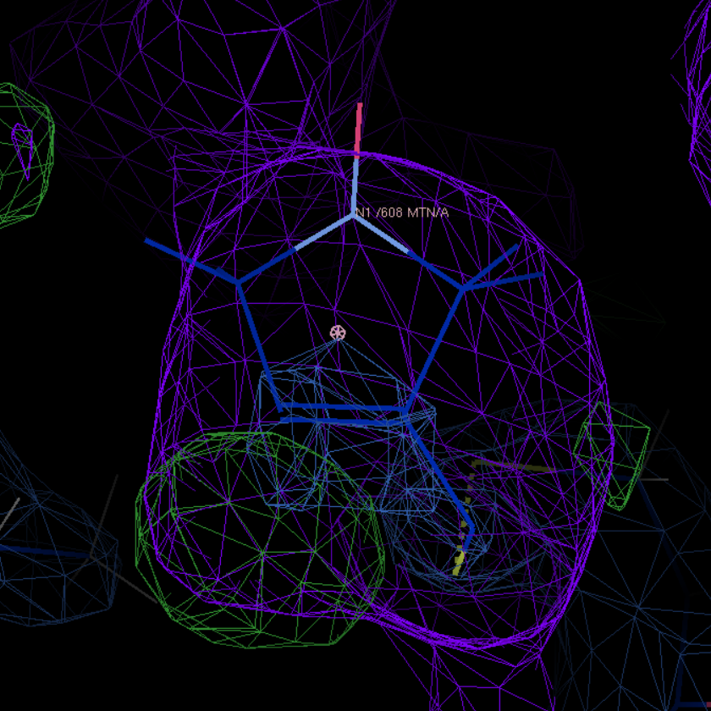
3m8b
chain A and resseq 608

Slide 27
Excluded MTN

Slide 28
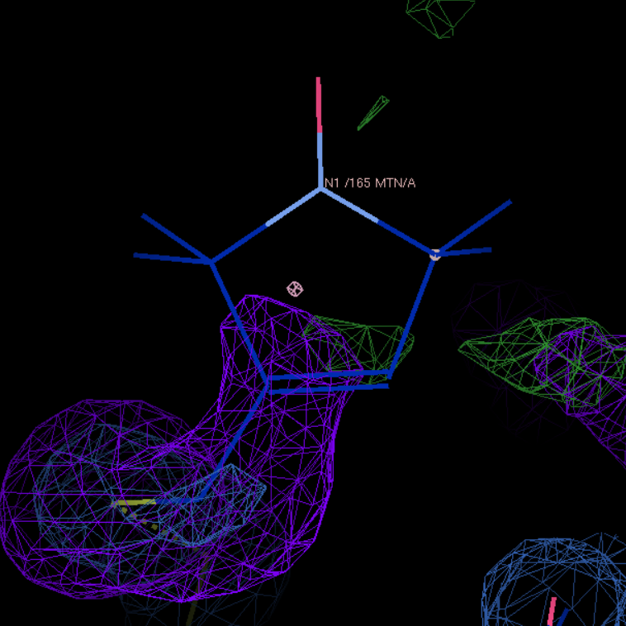
1zyt
1ZYT chain A and resseq 165

Slide 29
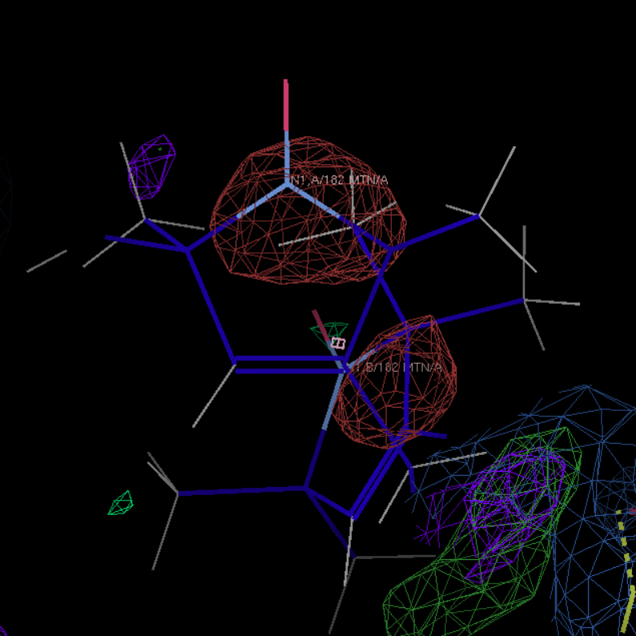
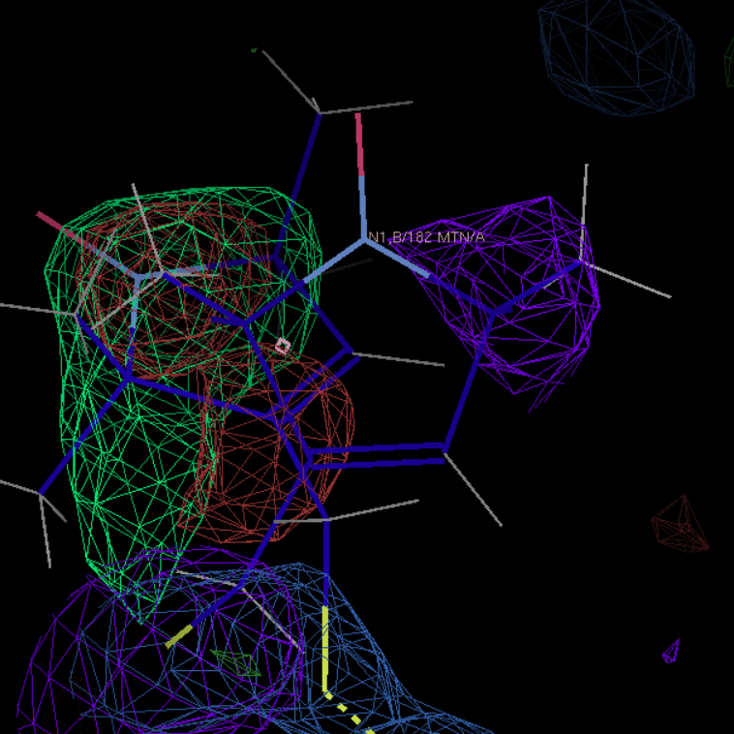
2cuu
chain A and resseq 182 and altloc A
chain A and resseq 182 and altloc B

Slide 30
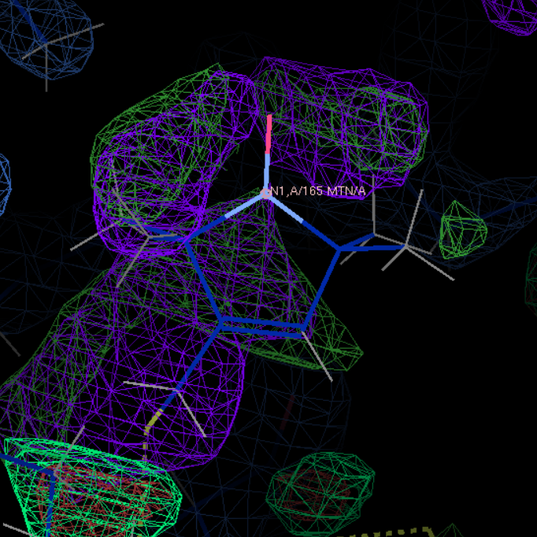
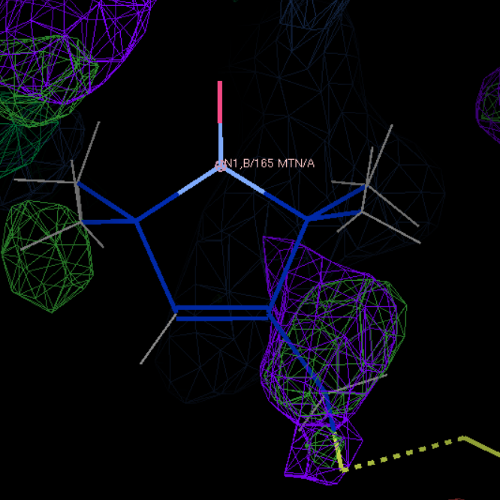
2ou8
chain A and resseq 165 and altloc A
chain A and resseq 165 and altloc B

Slide 31
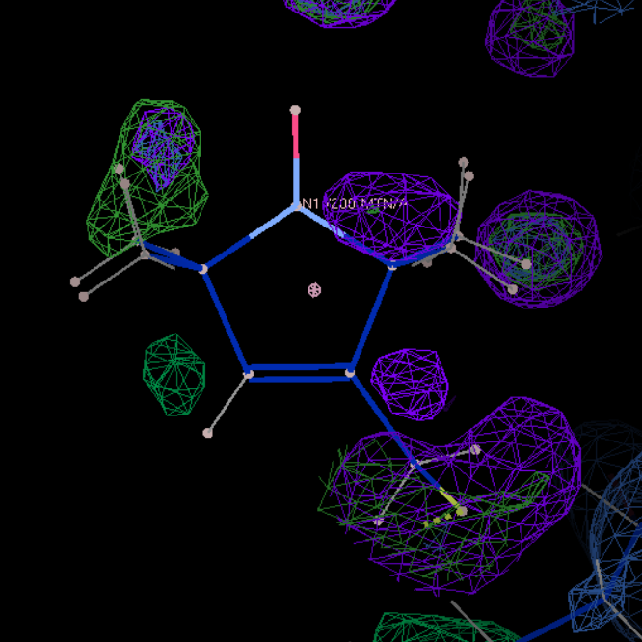
2ou9
chain A and resseq 200

Slide 32
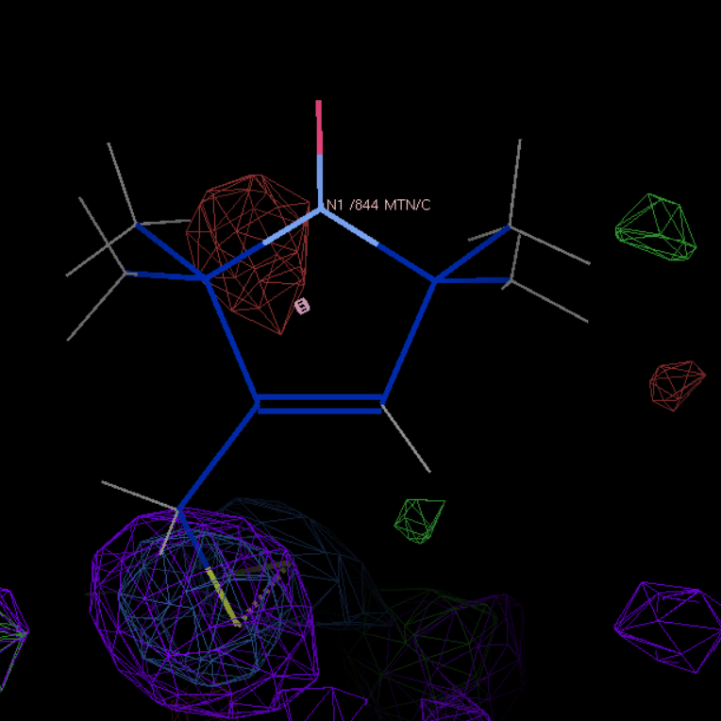
2q9e
chain C and resseq 844

Slide 33
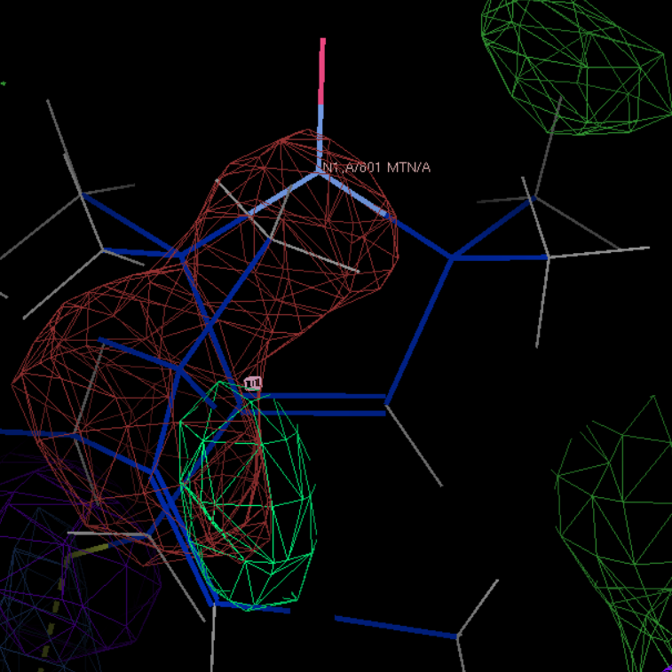
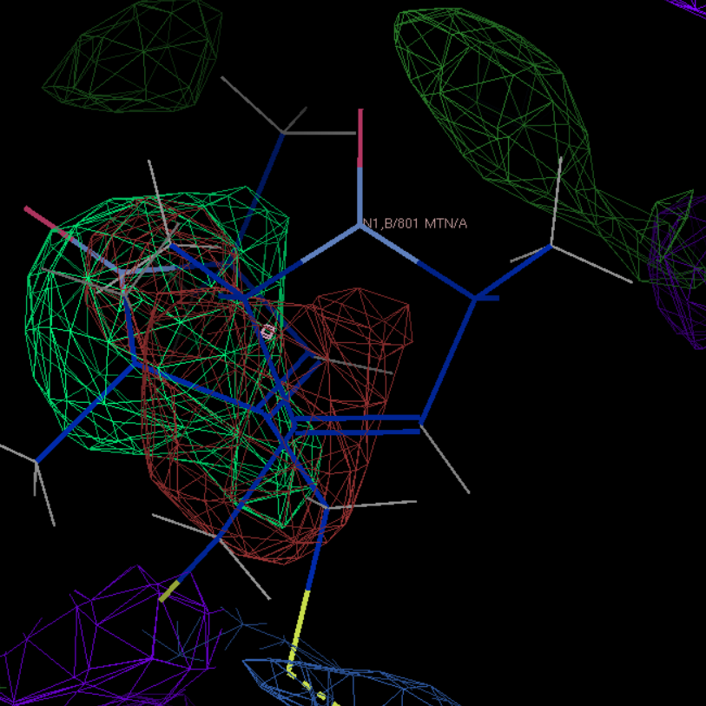
3g3v
chain A and resseq 801 and altloc A
chain A and resseq 801 and altloc B

Slide 34
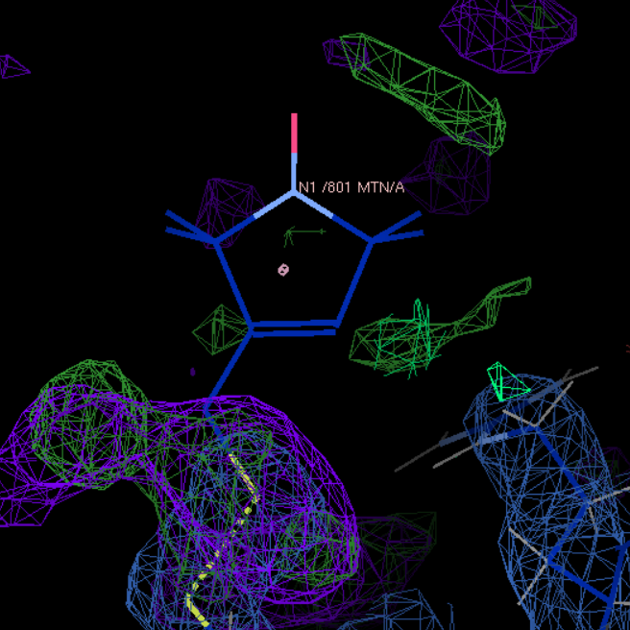
3g3w
chain A and resseq 801

Slide 35
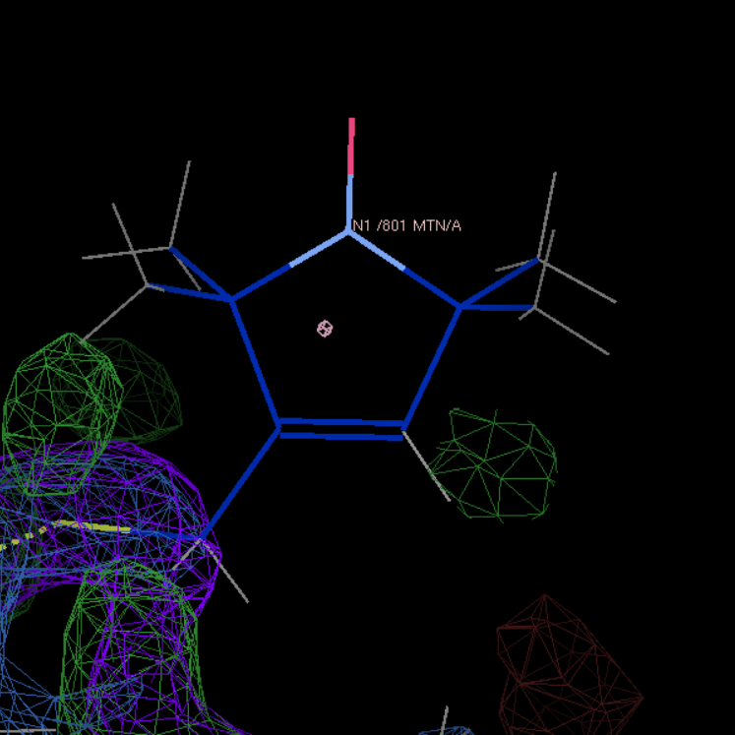
3g3x
chain A and resseq 801

Slide 36
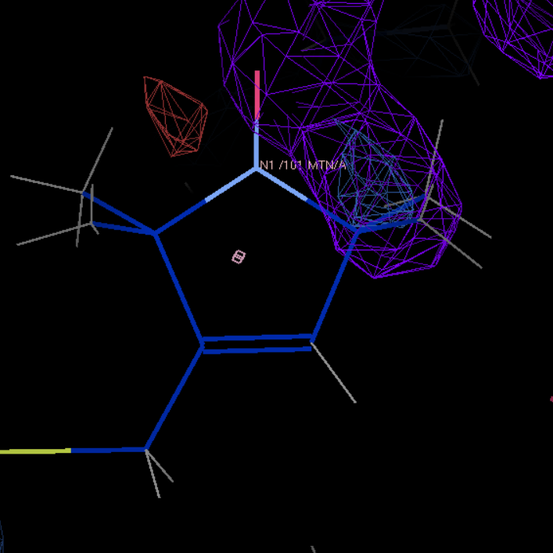
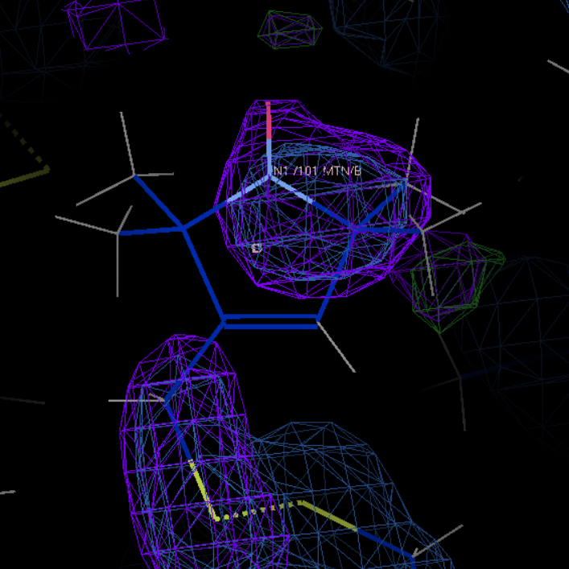
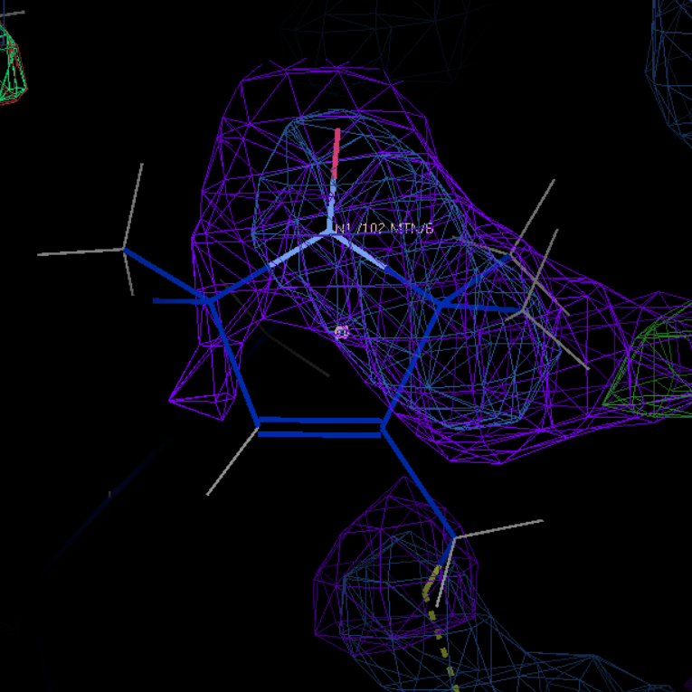
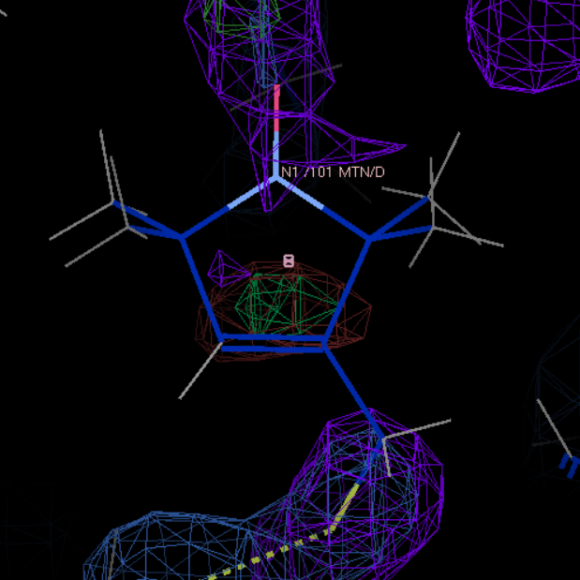
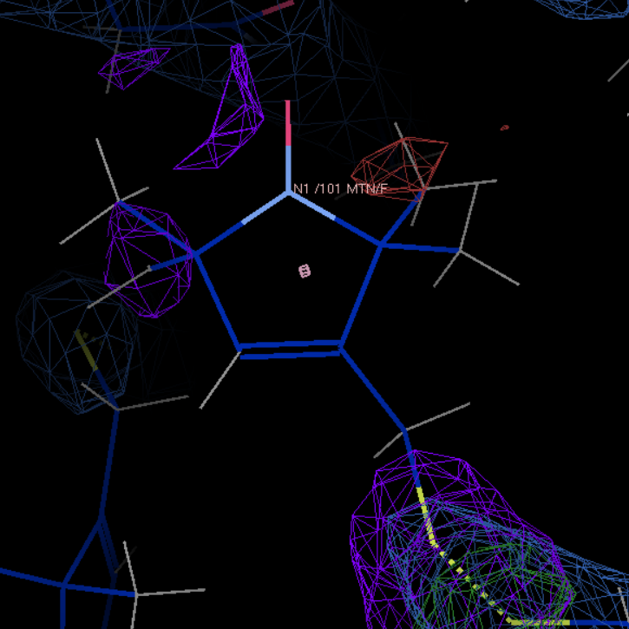
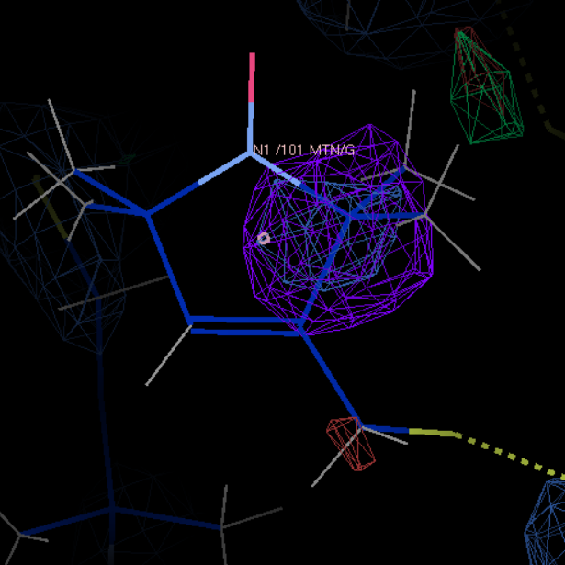
5bmg
chain A and resseq 101
chain B and resseq 101
chain B and resseq 102
chain D and resseq 101
chain F and resseq 101
chain G and resseq 101

Slide 37
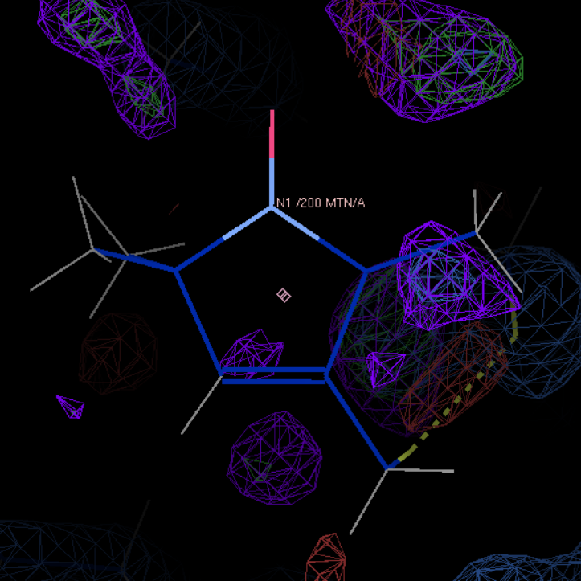
5uui
chain A and resseq 200

Slide 38
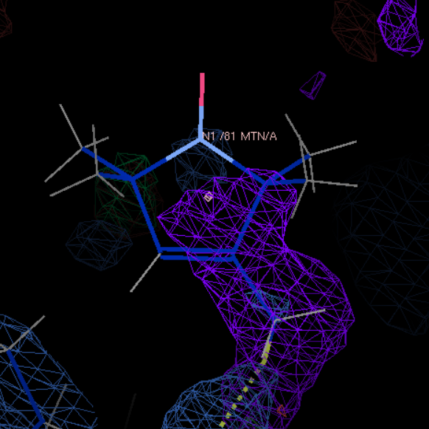







3v3x
Excluded for chain B and resseq 281 has incomplete MTN
chain A and resseq 81
chain B and resseq 81 and altloc A
chain B and resseq 81 and altloc B
chain C and resseq 281
chain C and resseq 81
chain D and resseq 281
chain D and resseq 81 and altloc A
chain D and resseq 81 and altloc B

Slide 39


3ifx
Excluded for chain A/C and resseq 248 haVE incomplete MTN
chain B and resseq 248
chain D and resseq 248

